Slide 1
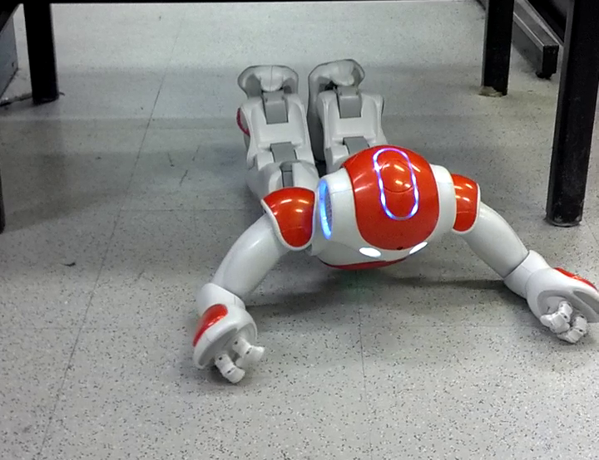

Projected Profile
Humanoid Crawl Gait
And
Lidar Based Navigation
Using GODZILA
Griswald Brooks
Advisor: Dr. Farshad Khorrami
12/22/2016

Slide 2
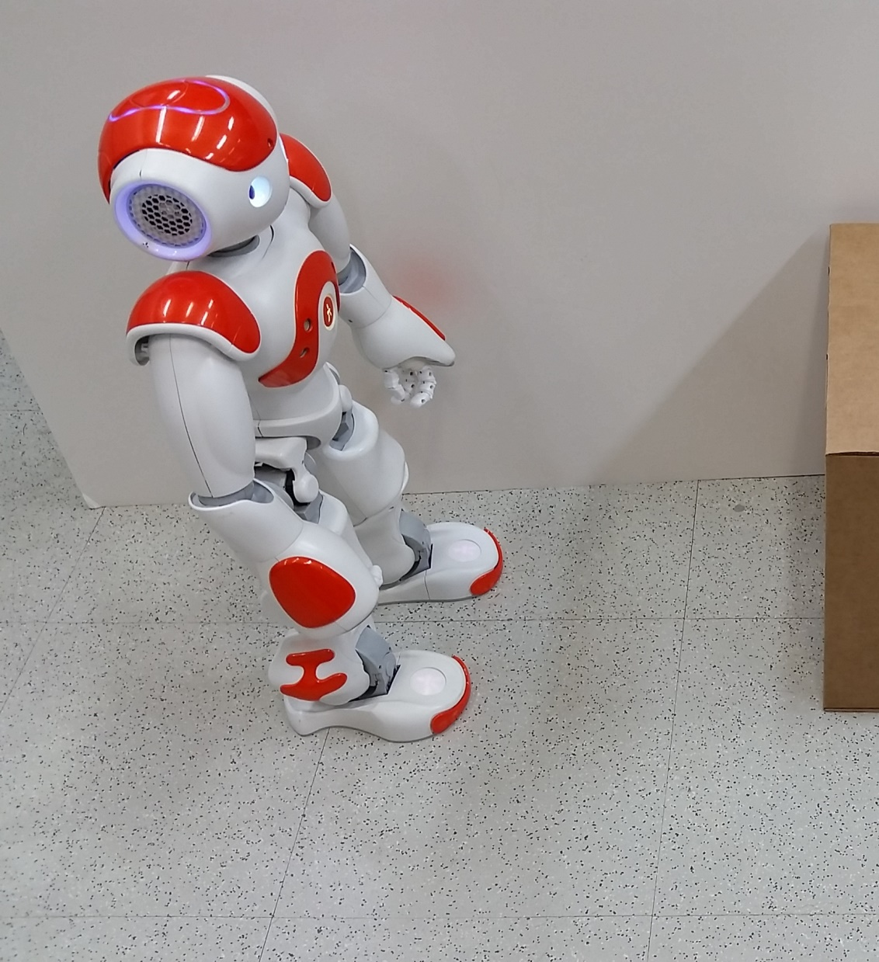
Presentation Outline

Slide 3
Presentation Outline
Introduction
Platform
GODZILA Navigation
Projected Profile Gait
Gait Optimization
Conclusion
12/22/2016
3

Slide 4
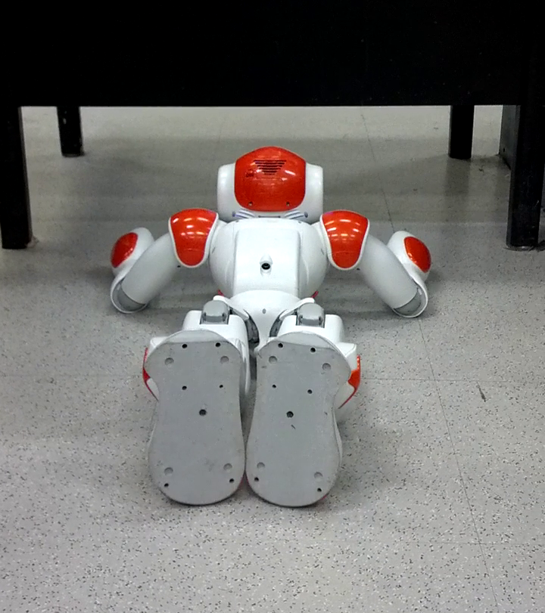
Introduction

Slide 5
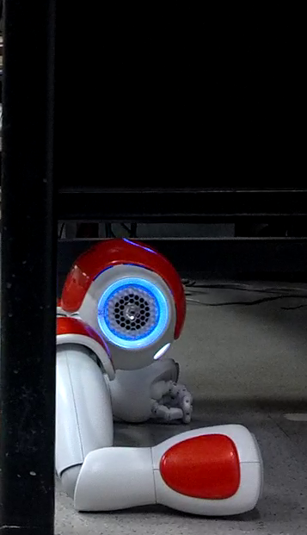
Introduction: Concept and Motivation
Humanoid Platform
Terrain adaptability
Mobile manipulation
Navigation
Safe traversal
Obstacle avoidance
Crawling
Stable gait
Expands navigable area
12/22/2016
5

Slide 6
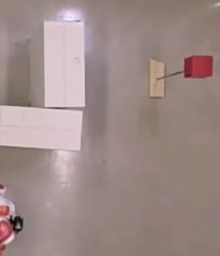
Introduction: GODZILA
GODZILA Navigation
Local planner
Computationally efficient
Foundation for global planners
12/22/2016
6

Slide 7
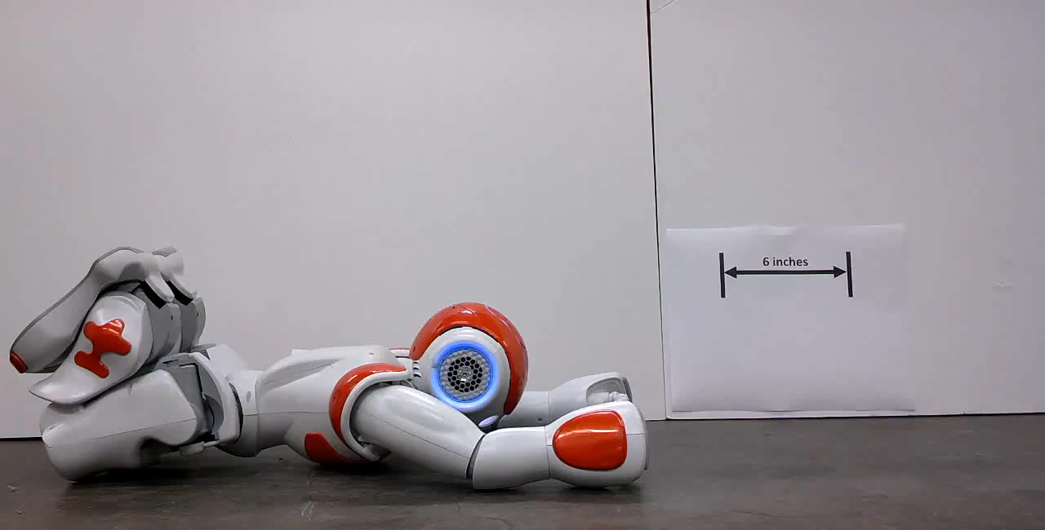
Introduction: Projected Profile
Projected Profile
Crawling gait
Widely applicable
Low profile
12/22/2016
7

Slide 8
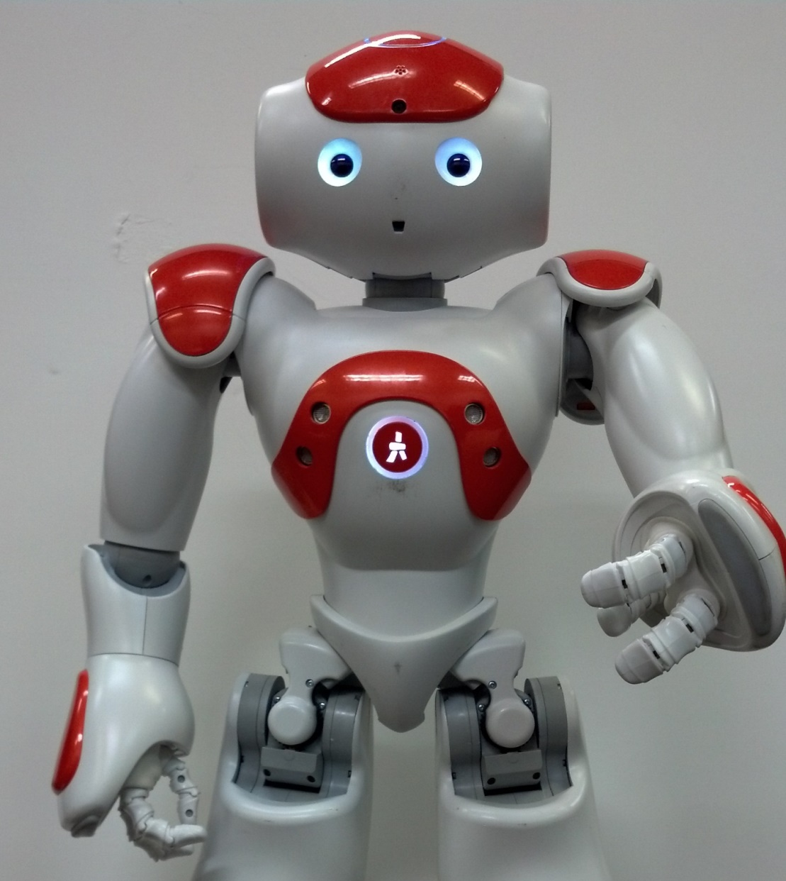
Platform Overview

Slide 9
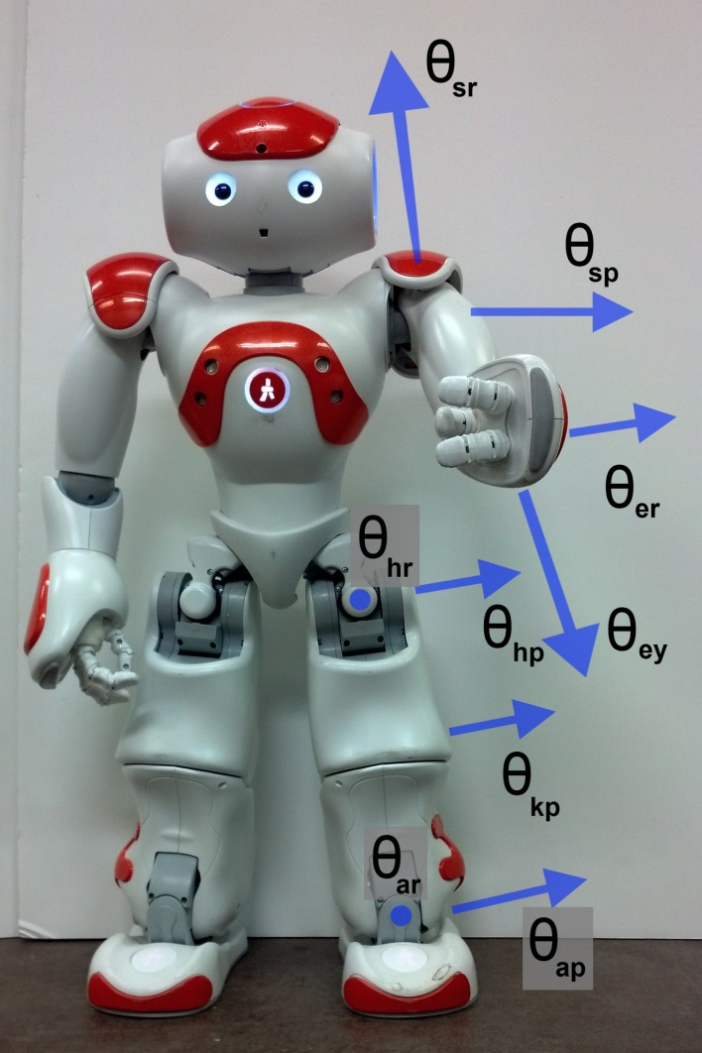
Platform Overview: Nao
Nao H25 Humanoid Platform
Aldebaran Robotics
25 DoF humanoid, 58 cm, 4.3 kg
Atom processor, cameras, sonars, IMU
Laterally symmetric, no back joint
12/22/2016
9

Slide 10
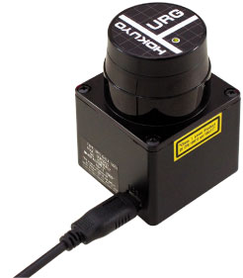
Platform Overview: Lidar
Hokuyo URG-04LXUG01
Scanning laser rangefinder
5 meter range, 0.3˚ angular resolution
USB
Obstacle avoidance
12/22/2016
10

Slide 11
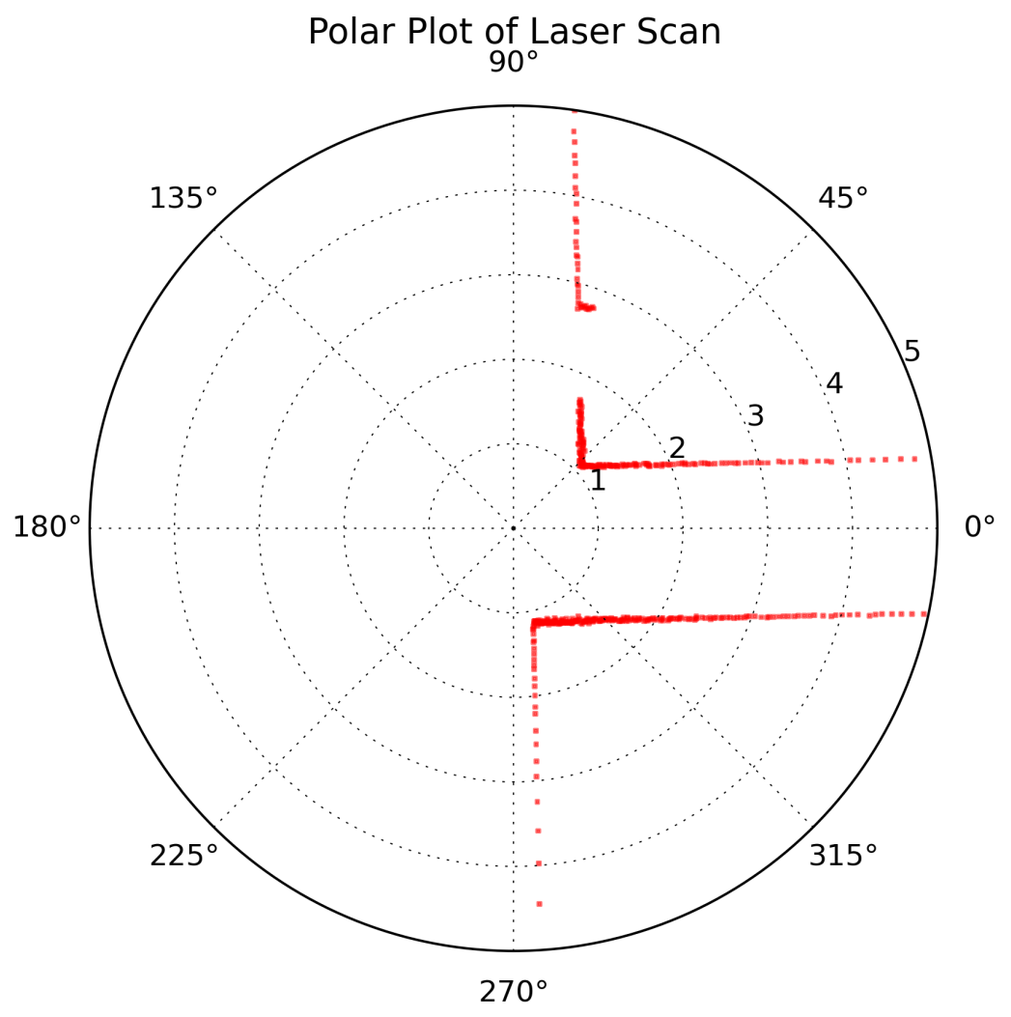
Platform Overview: Lidar
Planar Environmental View
720 range measurements
Room with hallway and door
12/22/2016
11

Slide 12
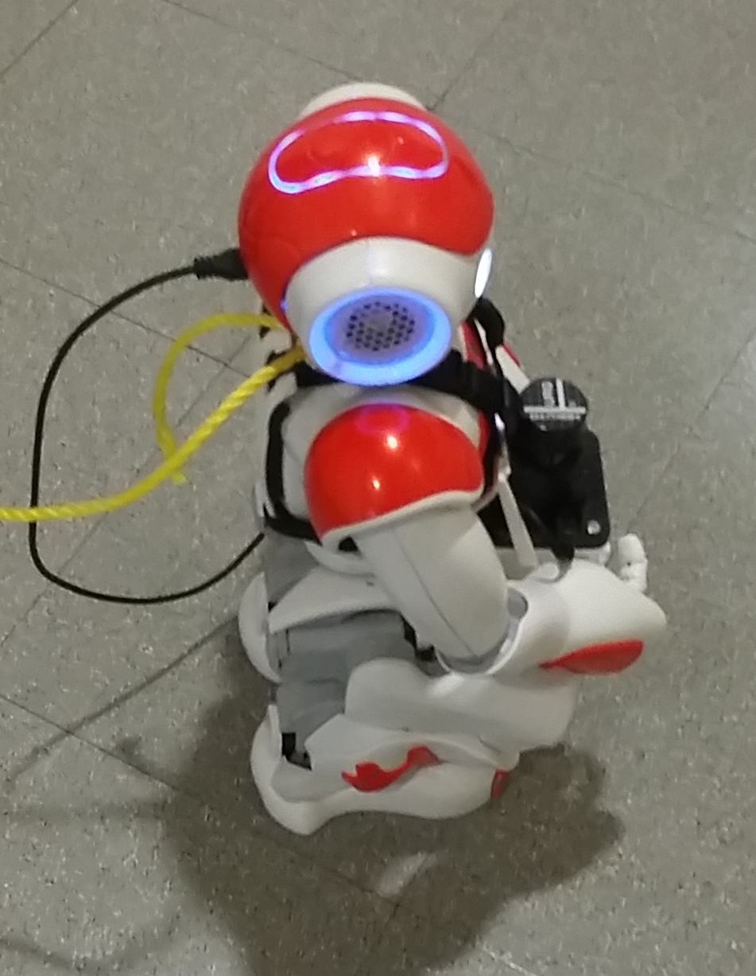
Platform Overview: Lidar Mount
Lidar Mount
Assembly to attach Lidar to Nao
3D printed plastic
Foam padding
Strapped to robot
12/22/2016
12

Slide 13
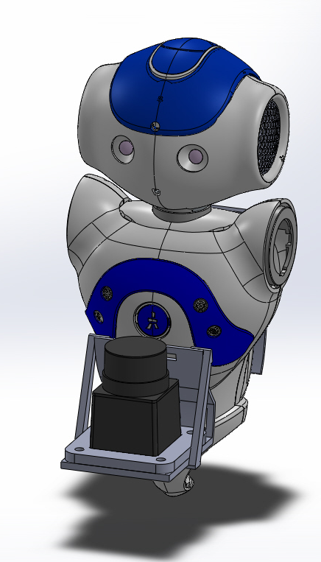
Platform Overview: Lidar Mount
Mount Design
Waist height, low center-of-gravity
Minimize wobble
Conform to body
Front subassembly, back plate
12/22/2016
13

Slide 14
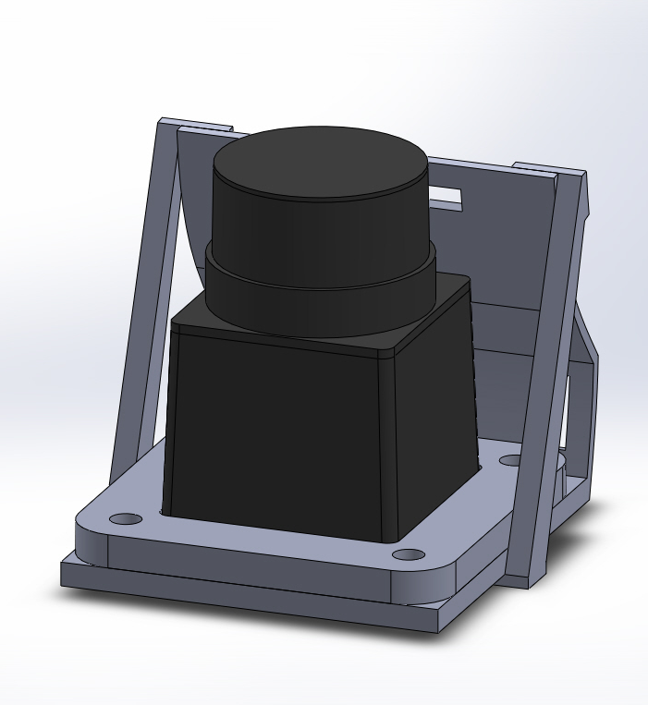
Platform Overview: Lidar Mount
Front Subassembly
Interchangeable plates
Reinforcement gussets
12/22/2016
14

Slide 15
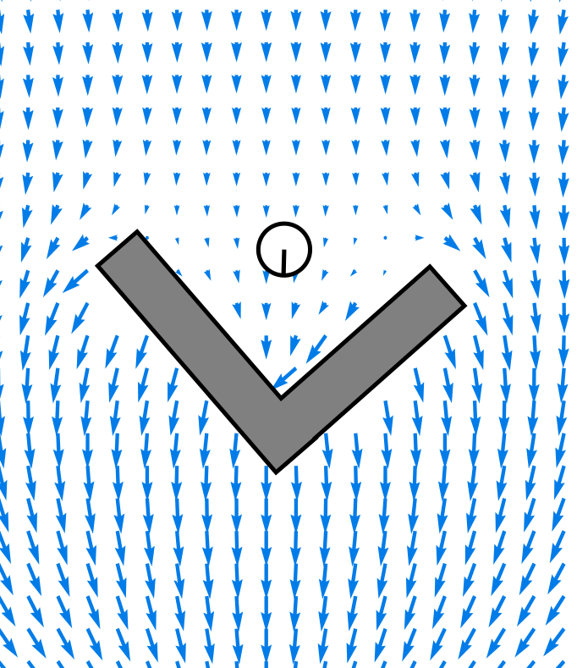
GODZILA
Navigation

Slide 16
GODZILA Navigation
Game-Theoretic Optimal Deformable Zone
with Inertia and Local Approach (GODZILA)
Local navigation
Potential Field
P. Krishnamurthy and F. Khorrami. Godzila: A low-resource algorithm for path planning in unknown environments. Journal of Intelligent and Robotic Systems, 48(3):357–373, 2007.
12/22/2016
16

Slide 17
GODZILA Navigation: Components
GODZILA Components
Rewards directions towards goal
Rewards directions towards far obstacles
Penalizes directions towards near obstacles
Penalizes changes in heading
12/22/2016
17

Slide 18
GODZILA Navigation: Potential Field
Potential Field
Force fields
Obstacle repulsion
Attractive goal
12/22/2016
18

Slide 19
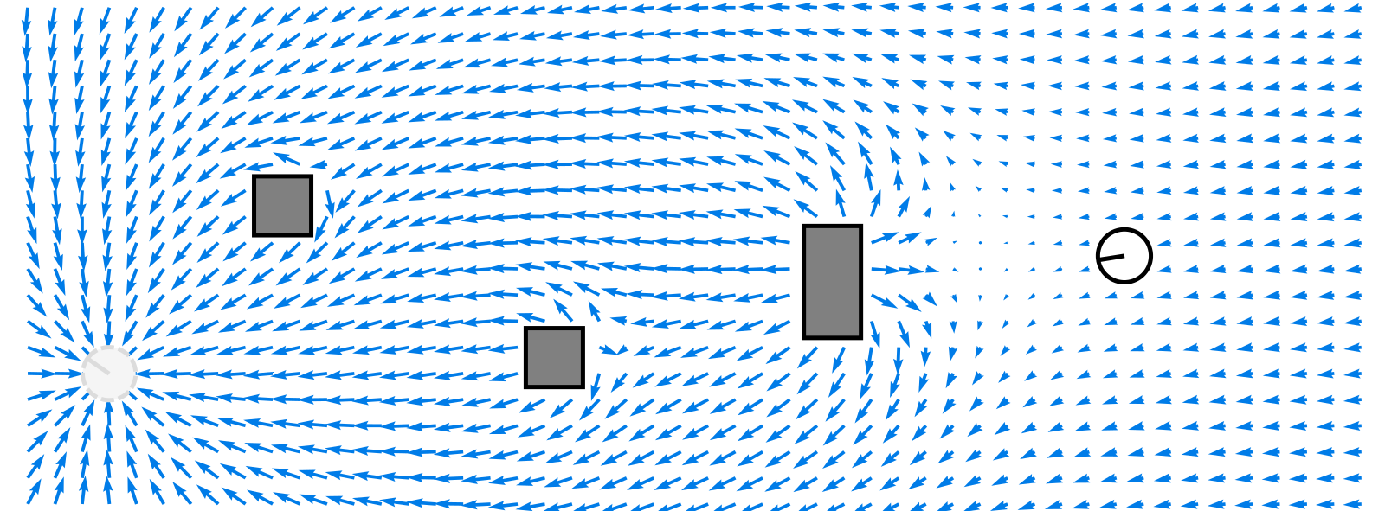
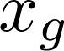
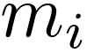

GODZILA Navigation: Potential Field
Goal
Obstacles
Robot
12/22/2016
19

Slide 20
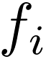
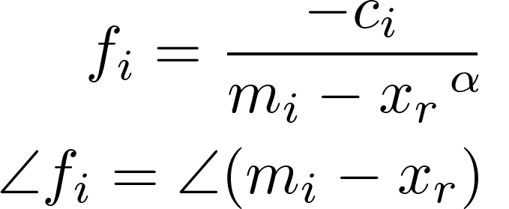


GODZILA Navigation: Potential Field
Obstacle Force Vector
Tuning parameter
Power
12/22/2016
20

Slide 21
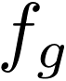
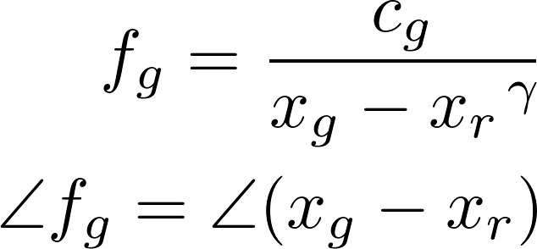
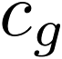

GODZILA Navigation: Potential Field
Goal Force Vector
Tuning parameter
Power
12/22/2016
21

Slide 22
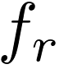
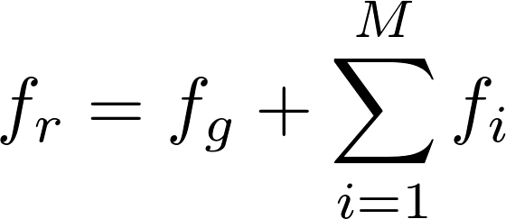

GODZILA Navigation: Potential Field
Robot Force Vector
Obstacle Set
12/22/2016
22

Slide 23
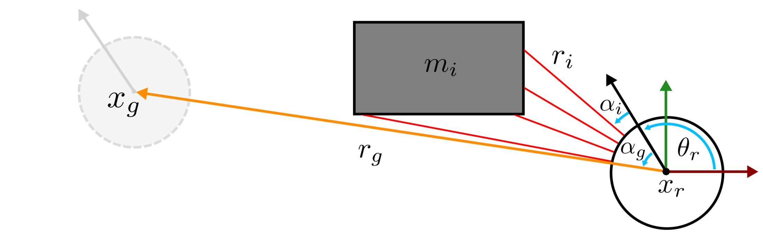
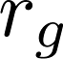
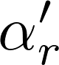
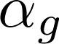
GODZILA Navigation: Parameters
goal location
range to goal
robot location
bearing to goal
new bearing command
12/22/2016
23

Slide 24

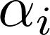
GODZILA Navigation: Parameters
obstacle
range of sensor measurement
bearing of sensor measurement
12/22/2016
24

Slide 25
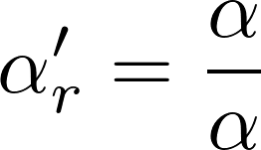
GODZILA Navigation: Equations
Bearing Command Vector
Sum of Component Vectors
12/22/2016
25

Slide 26
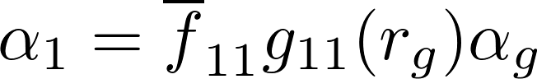
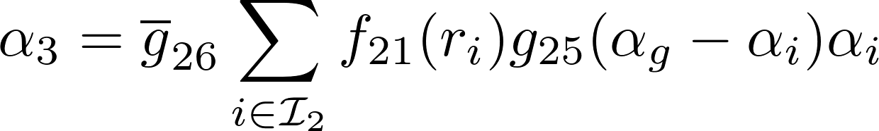
GODZILA Navigation: Reward Vectors
Goal Reward Vector
Far Obstacle Reward Vector
12/22/2016
26

Slide 27
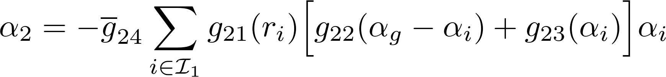
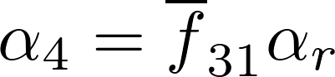
GODZILA Navigation: Penalty Vectors
Near Obstacle Penalty Vector
Inertia Vector
12/22/2016
27

Slide 28
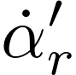
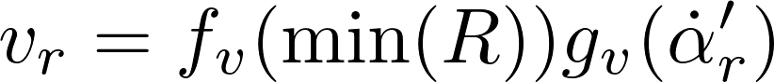
GODZILA Navigation: Forward Velocity
Angular Rate Command
Forward Velocity Command
12/22/2016
28

Slide 29
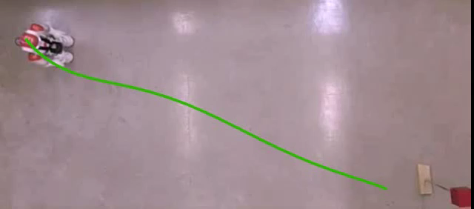
GODZILA Navigation: Open Area
12/22/2016
29

Slide 30
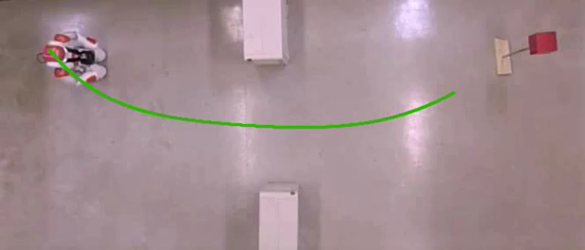
GODZILA Navigation: Narrow Opening
12/22/2016
30

Slide 31
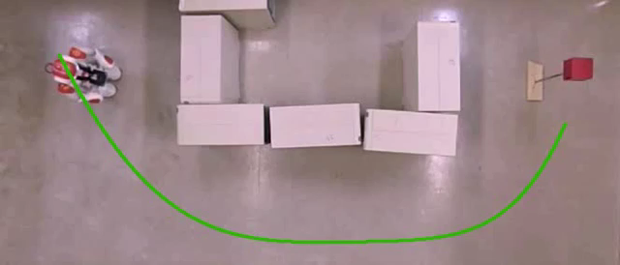
GODZILA Navigation: Square Area
12/22/2016
31

Slide 32
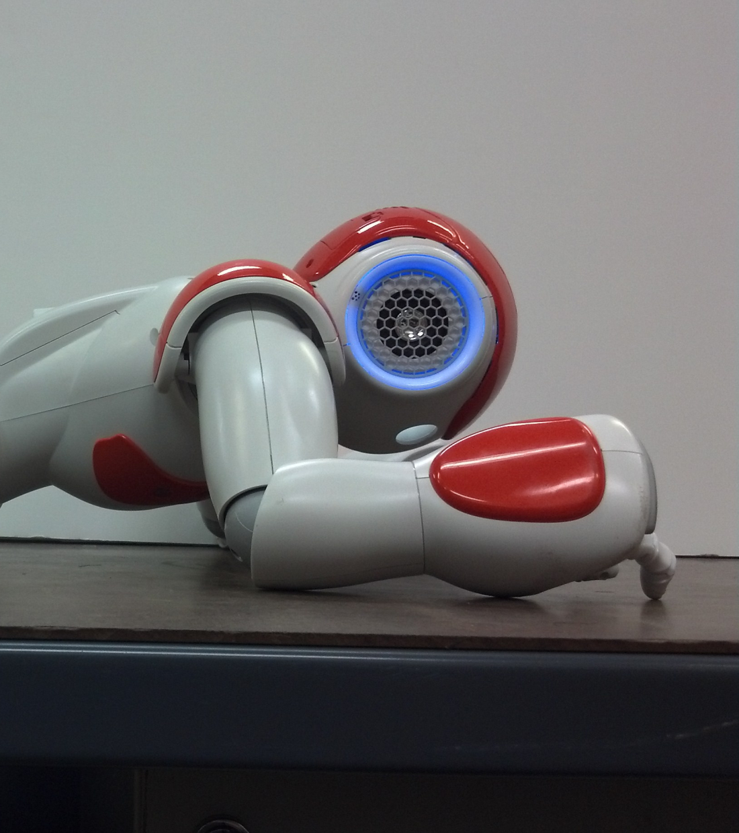
Projected Profile

Slide 33
Projected Profile
Projected Profile
Crawling gait
Sagittal plane projection
25 DoF to 6 DoF
G. Brooks, P. Krishnamurthy, and F. Khorrami. Low-profile crawling for
humanoid motion in tight spaces. In 2015 IEEE/RSJ International Conference
on Intelligent Robots and Systems (IROS), pages 5930–5935, Sept 2015.
12/22/2016
33

Slide 34
Projected Profile: Modes
Modes
Open chain, move end effectors
Closed chain, move center-of-mass
12/22/2016
34

Slide 35
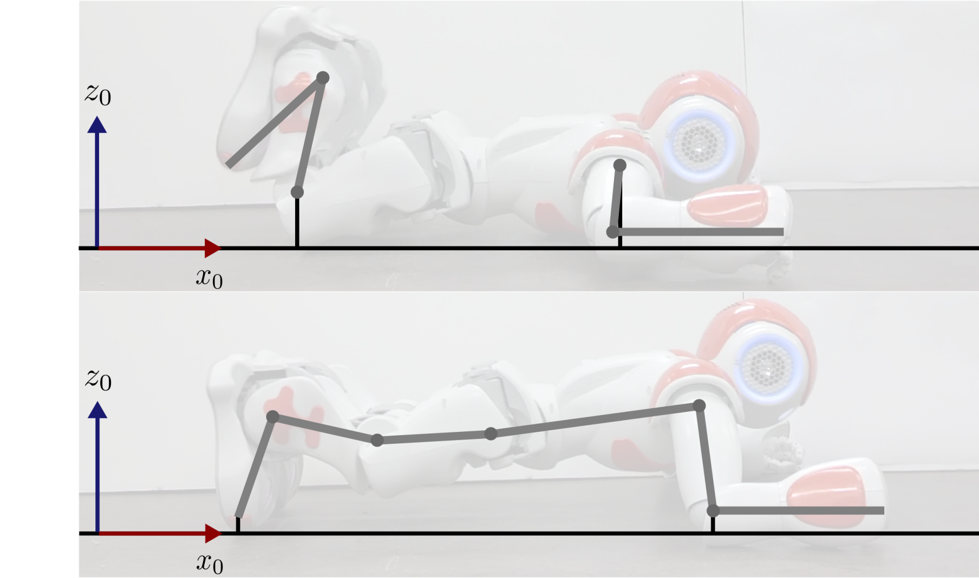
Projected Profile: Modes
Open Chain
Closed Chain
12/22/2016
35

Slide 36
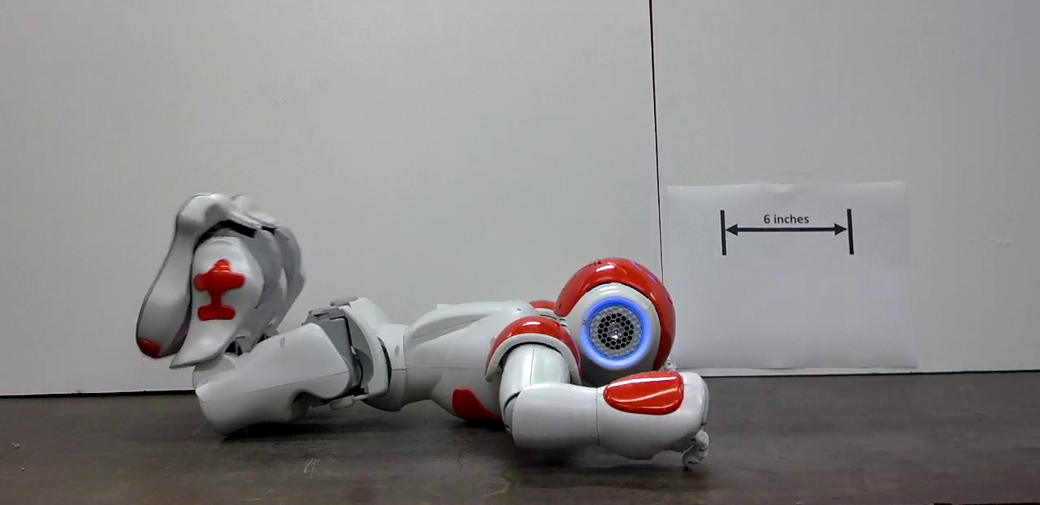
Projected Profile: Open Chain
Open Chain
Torso on ground
Arms and legs are positioned
12/22/2016
36

Slide 37
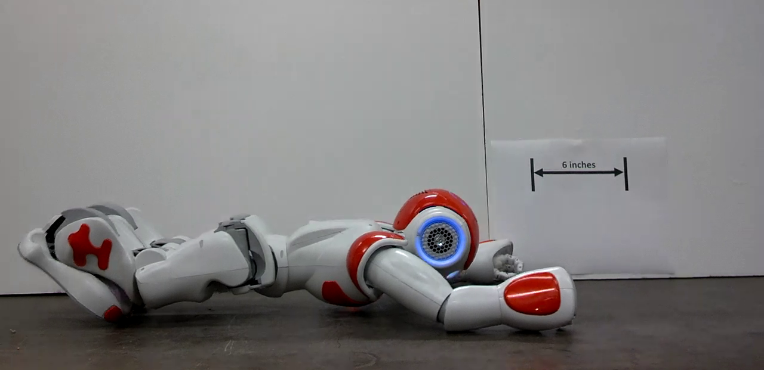
Projected Profile: Closed Chain
Closed Chain: Extension
Arms and legs on ground
Torso can be positioned
CoM is at initial position
12/22/2016
37

Slide 38
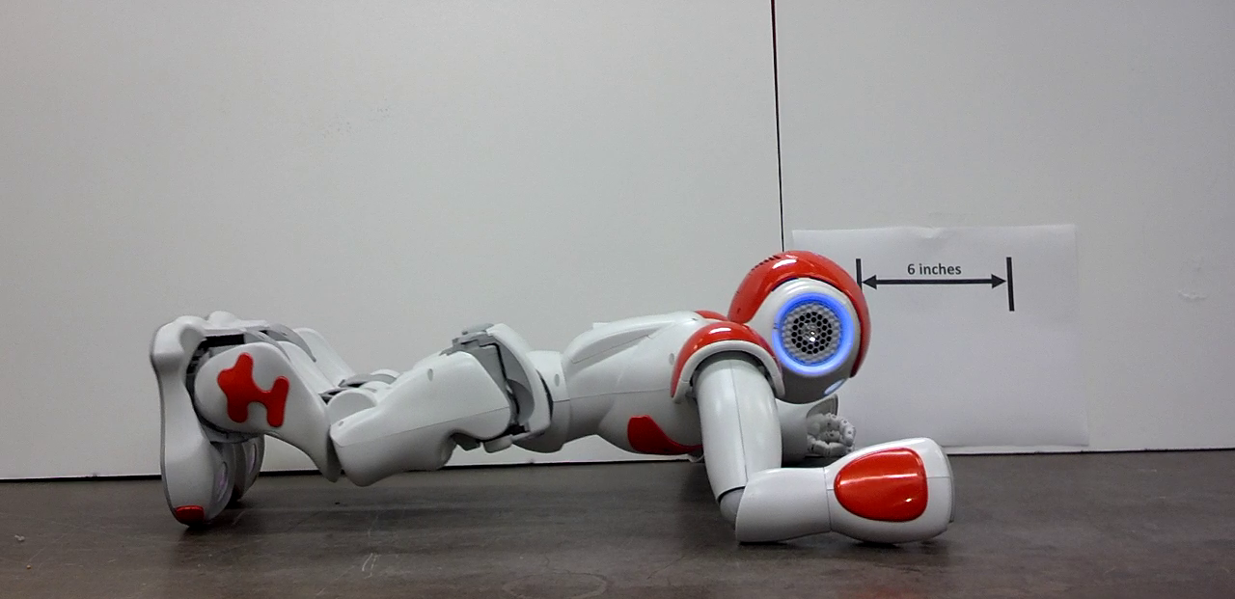
Projected Profile: Closed Chain
Closed Chain: Compression
CoM is at final position
12/22/2016
38

Slide 39
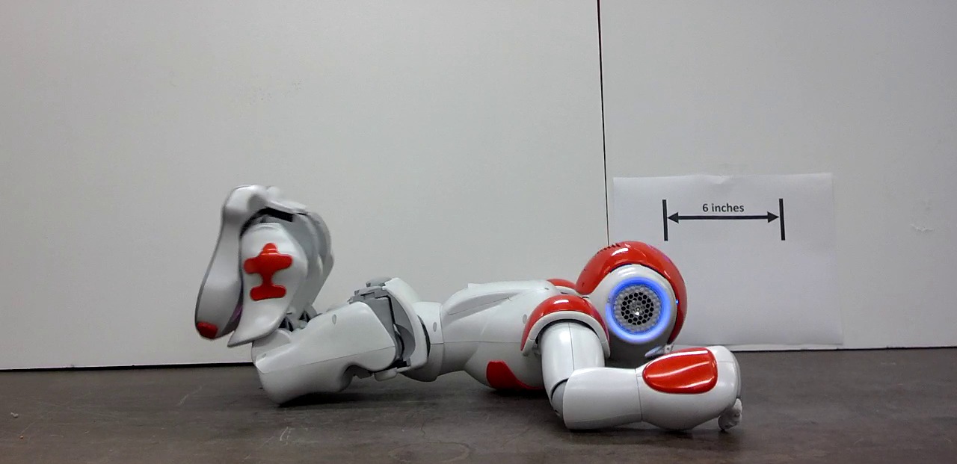
Projected Profile: Open Chain
Open Chain
Torso on ground
Arms and legs can again be positioned
12/22/2016
39

Slide 40
Projected Profile: Crawling On Table
12/22/2016
40

Slide 41
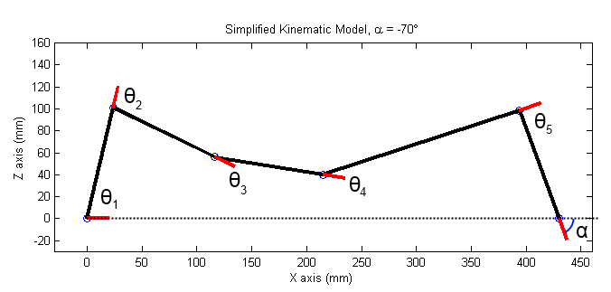
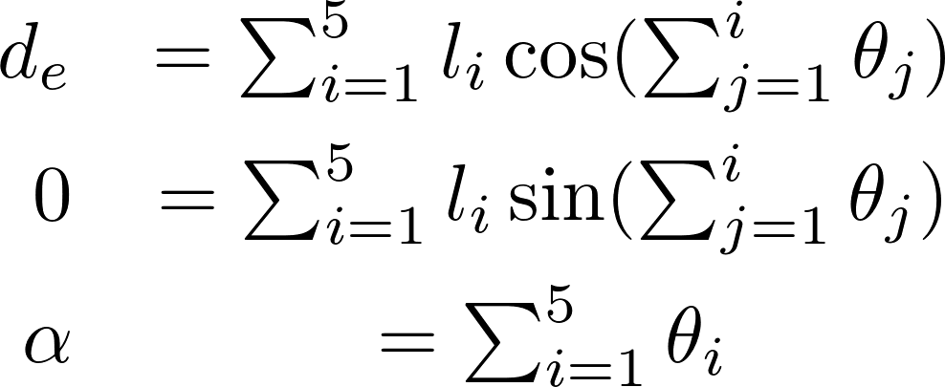
Projected Profile: Closed Chain Equations
Foot “joint” is not actuated
Knee and hip as free variables
Remaining joints function of Projected Profile elbow
12/22/2016
41

Slide 42
Projected Profile: Ankle Solution
Ankle Joint Equation
Squared sum formulation
12/22/2016
42

Slide 43
Projected Profile: Ankle Solution
Ankle Joint Solution
Yields two solutions for Ankle
One is kinematically infeasible
12/22/2016
43

Slide 44
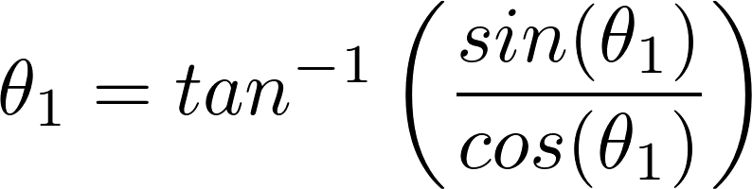
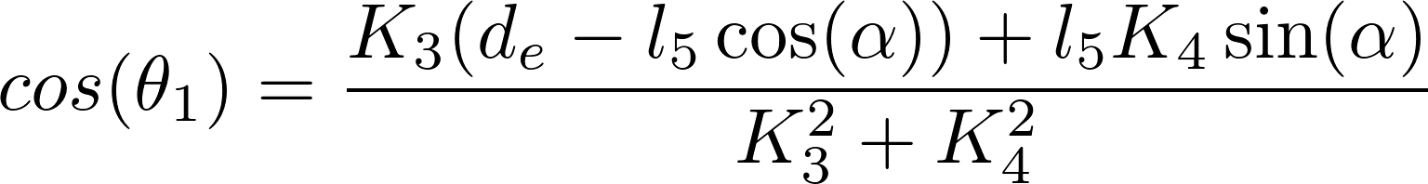
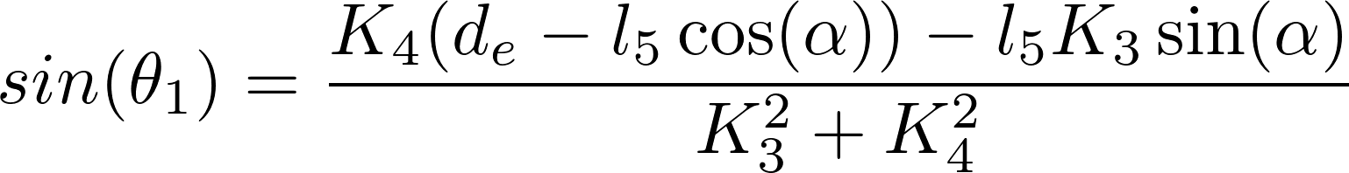
Projected Profile: Foot Solution
Foot Joint Solution
Follows from ankle solution
12/22/2016
44

Slide 45
Projected Profile: Foot Solution
Foot Joint Solution
12/22/2016
45

Slide 46

Projected Profile: Shoulder Solution
Shoulder Joint Solution
12/22/2016
46

Slide 47




Projected Profile: Nao Arm
Nao Arm
Not planar
Shoulder Roll
Elbow Yaw
Elbow Roll
12/22/2016
47

Slide 48





Projected Profile: Nao Arm
Arm Brace Parameters
Humerus Length
Shoulder Width
Forearm Width Elbow Extension
12/22/2016
48

Slide 49

Projected Profile: Nao Arm
Shoulder Roll Solution
12/22/2016
49

Slide 50




Projected Profile: Nao Arm
Forearm Vector
Desired Forearm Vector
12/22/2016
50
50

Slide 51




Projected Profile: Nao Arm
Desired Forearm Vector
Projected Humerus Length
Forearm Vector
=
12/22/2016
51

Slide 52

Projected Profile: Nao Arm
Elbow Yaw Axis
Elbow Roll Axis
12/22/2016
52

Slide 53


Projected Profile: Elbow Solution
Required Elbow Roll Axis
Elbow Yaw Solution
12/22/2016
53

Slide 54

Projected Profile: Elbow Solution
Elbow Roll Solution
12/22/2016
54

Slide 55

Projected Profile: Animation
Z axis (mm)
X axis (mm)
12/22/2016
55

Slide 56

Projected Profile: Crawl Sequence

Slide 57

Gait Optimization

Slide 58
Gait Optimization
Knee and hip as free variables
Optimize joint torque use
Pseudo-static formulation
12/22/2016
58

Slide 59

Gait Optimization: Method
V-REP simulation
Table of joint-angles-to-torques
2.5˚ resolution
± 30˚ about initial pose
Linear interpolation
Genetic algorithm for optimization
12/22/2016
59

Slide 60


Gait Optimization: Triplet
Angle Triplets Cubic Splines
12/22/2016
60

Slide 61

Gait Optimization: Cost Functions
Torque Cost Function
Minimize joint torques
Shoulder weighted more to minimize use
12/22/2016
61

Slide 62

Gait Optimization: Cost Functions
Joint Limit Indicator Functions
12/22/2016
62

Slide 63


Gait Optimization: Cost Functions
Hip Height Indicator
Backtracking Indicator
12/22/2016
63

Slide 64

Gait Optimization: Cost Functions
Indicator Cost Function
12/22/2016
64

Slide 65

Gait Optimization: Cost Functions
Total Cost Function
12/22/2016
65

Slide 66

Crawl Gait: Projected Profile
Z axis (mm)
X axis (mm)
12/22/2016
66

Slide 67

Crawl Gait: Projected Profile
12/22/2016
67

Slide 68

Gait Optimization: Torque Cost Improvement
Joint Torque Cost
Torque use
Simulated in V-REP
Gait duration
Pseudo-static
12/22/2016
68

Slide 69

Gait Optimization: Torque Cost Improvement
Joint Torque Cost
Torque use improvement
12/22/2016
69

Slide 70

Conclusion

Slide 71

Conclusion
Platform
GODZILA
Projected Profile
Optimization
12/22/2016
71

Slide 72
Conclusion
Future Work
Structure from motion
Trap avoidance
Crawl gait turning
12/22/2016
72

